Slide 1
Symbols
Animal Farm presentation

Slide 2
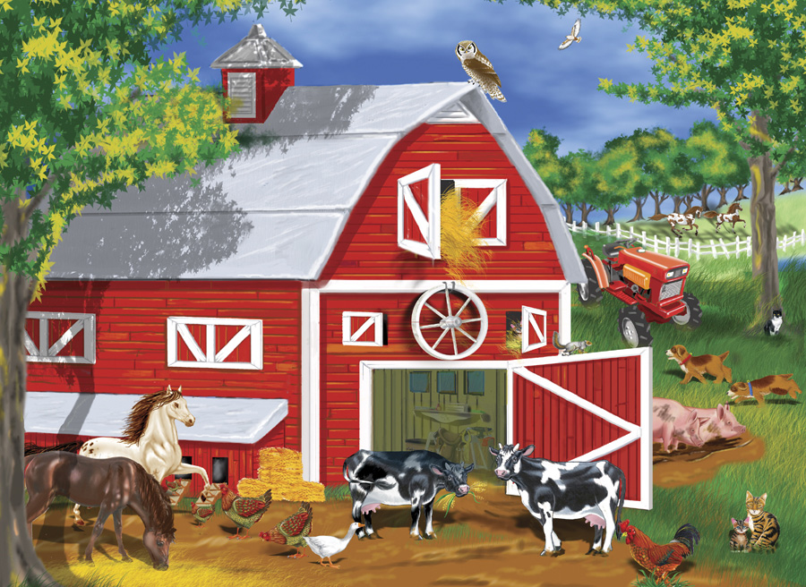
Animal farm
Russia and the Soviet Union
internal structure of a nation
political entity with diplomatic
concerns

Slide 3
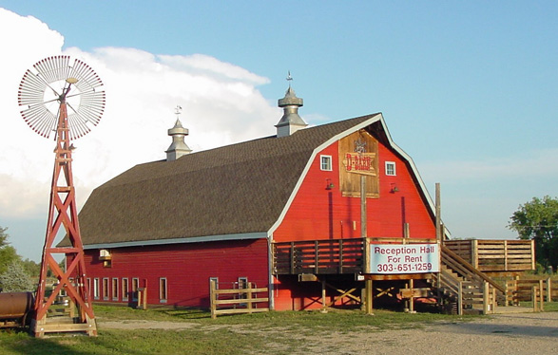
The barn
collective memory of a
modern nation
many scenes in which the ruling-class pigs alter Animalism

Slide 4
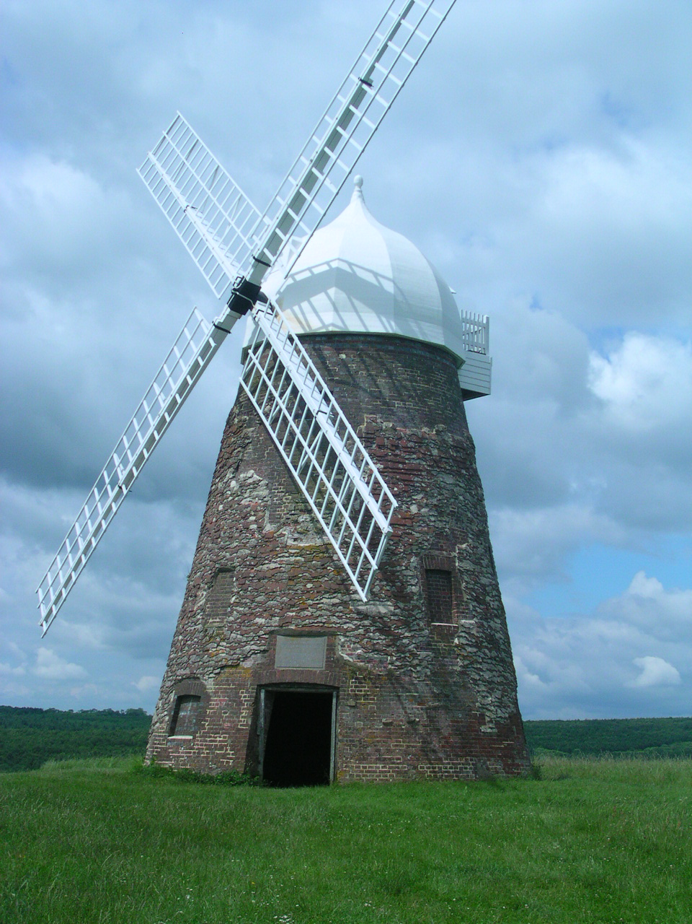
The windmill
innovation and progress
will lead to an easier life
technological advancements
could keep people busy

Slide 5
